Slide 1
Data Analysis in Criminal Justice
Probability Continued

Slide 2
Contingency Tables
Contingency table (“cross-tab”)
Illustrates the joint distribution of two variables
Defined by number of rows and number of columns
2 X 2 Contingency table
Independent Variable
 | ~X | X | Total
~Y | f₁₁ | f₁₂ | f_{1•}
Y | f₂₁ | f₂₂ | f_{2•}
Total | f_{•1} | f_{•2} | n
Dependent Variable
Row Marginals
Column Marginals

Slide 3
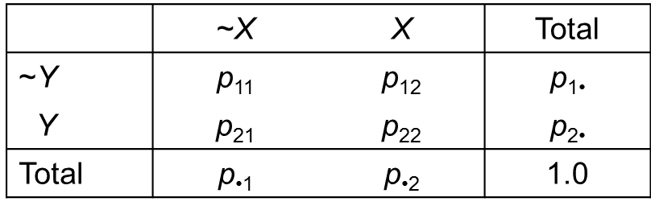
Contingency Tables (cont.)
An alternative representation
Relative frequencies instead of frequencies
Joint probabilities in the middle, unconditional probabilities on the margins
p₂₂ = p(X ∩ Y)
p_{2•} = p₂₁ + p₂₂ = p(~X ∩ Y) + p(X ∩ Y) = p(Y)

Slide 4
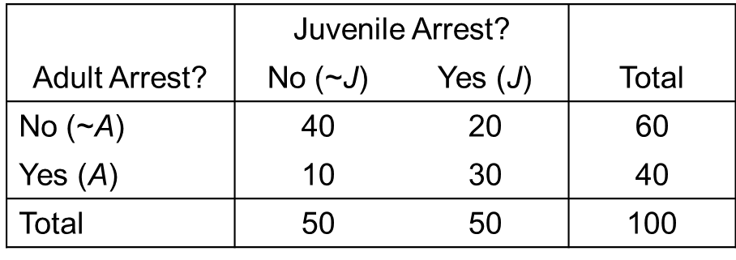
Relationship Between Two Categorical Variables
Example: juvenile & adult arrests
Are juvenile and adult arrests independent?
Does knowing that someone was arrested as a juvenile help us predict whether or not they are arrested as an adult?
Not necessary to be a perfect prediction, only “better than chance” prediction, or “more likely than not”

Slide 5
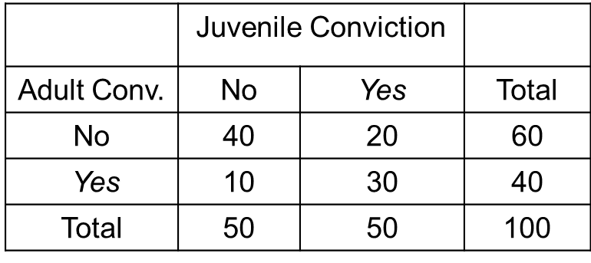
Conditional Probabilities
Are juvenile and adult arrests independent?
Recall rule of independence: If p(A|B) = p(A) or p(B|A) = p(B), then A & B are independent
Are J and A independent in this cross-tab?
p(A) = 40 / 100 = .40
p(A|J) = 30 / 50 = .60
Not independent…Worth investigating in detail

Slide 6
Conditional Probabilities (cont.)
What is the nature of the relationship between juvenile and adult arrest?
Arrested juveniles are 200% more likely to be arrested as an adult than non-arrested juveniles.
p(A|J) = 30 / 50 = .60
p(A|~J) = 10 / 50 = .20
% Difference = (.60 - .20) / .20 x 100 = 200%

Slide 7
Chi-Square Test of Independence
Formal test of whether to categorical (N,O) variables are statistically independent
Compare observed frequencies with expected frequencies under assumption of independence
Chi-square relies on multiplication rule for independent events
p(A ∩ B) = p(A) × p(B)
How much does our contingency table depart from what we would expect if two variables were truly independent?

Slide 8
Data Analysis in Criminal Justice
Population, Sample, & Sampling Distributions

Slide 9
Logic of Sampling
Our goal is to use information from a sample to make inferences about the larger population
We want to use as a “best guess” for μ

Slide 10
Logic of Sampling (cont.)
Population mean (μ)
Empirical: Can be measured
Unknown: Impractical to measure
Fixed: one “true” value (constant)
Sample Mean (xbar)
Empirical: can be measured
Known: actually have data to measure it
Not fixed: varies from sample to sample (variable)

Slide 11

Sampling Error
Estimate of $μ$ will differ from one sample to another, even though samples are random draws from the same population
Sampling error produces randomness in the estimate of the mean
Within a population, the mean is constant
Within a sample, the mean is a constant
Across samples, the mean is a variable

Slide 12
Thought Experiment
Random sample size n , compute xbar
Compute xbar from second random sample, then third, fourth, fifth, etc., an infinite number of times
What do you think is going to happen?
Xbar

Slide 13
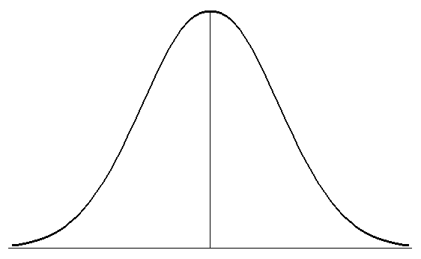



Sampling Distribution
Distribution of all possible sample means
Theoretical (vs. empirical)
Known: probability theory
Centered around true population mean, $μ$

Slide 14
Properties of Sampling Distributions
We can imagine our sample mean as but one mean from a theoretical distribution of all possible sample means
We can use the laws of probability to determine the probability of obtaining our particular sample mean
Properties of sampling distributions
As n increases, the standard error decreases
Always normally distributed if the population is normally distributed

Slide 15
Central Limit Theorem
If an infinite number of sample sizes “n” are drawn from the population, the sampling distribution will approach normality as the sample size becomes infinitely large, even if the characteristic is not normally distributed in the population
Even though a variable like “number of arrests” is highly skewed in the population, we can still assume that the sampling distribution will be normal when we have a large sample

Slide 16

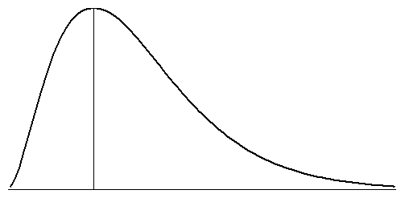

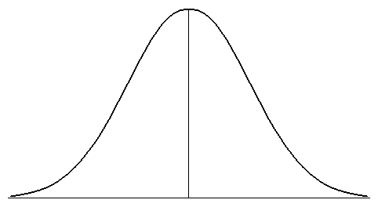


Central Limit Theorem (cont.)
Population distribution (N observations)
Sampling distribution (n observations)

Slide 17
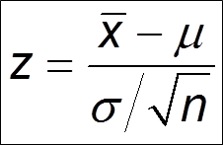

Standard Score for a Sample Mean
We want to standardize a sample mean with respect to $μ$, in standard error units

Slide 18
Intelligence
μ = 100, σ = 15, n = 50
p(xbar > 97) =
p(xbar <95) =
p(105 < xbar < 120) =

Slide 19
Household Income
μ = $32,000, σ = $5,000, n = 30
p(xbar < 30000) =
p(xbar > 33000) =
p(31500 < xbar < 32500) =

Slide 20
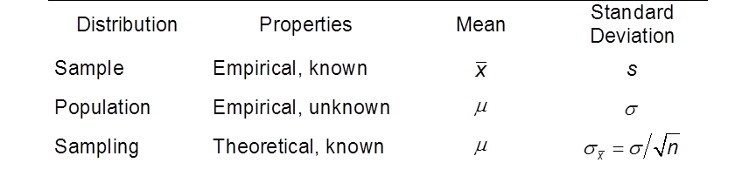
Sampling Distribution Redux

Slide 21
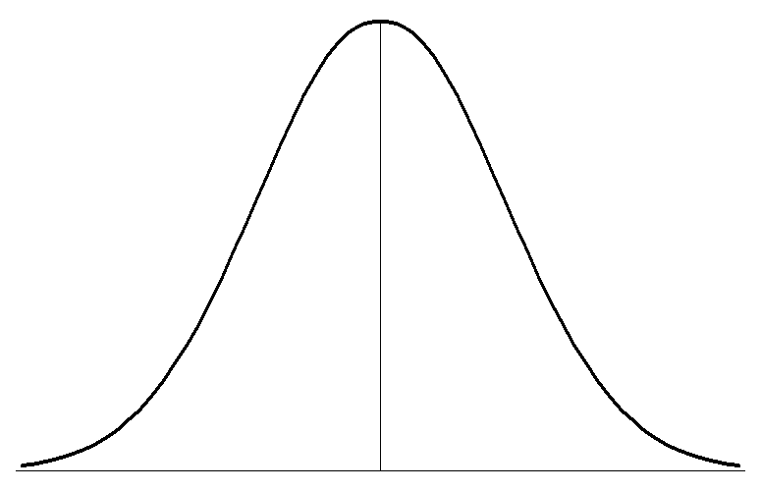



Central Limit Theorem Redux
With large “n”, the sampling distribution is approximately normal, even if the characteristic is not normally distributed in the population

Slide 22
Social Research II
Point Estimates & Confidence Intervals

Slide 23
Interval Estimation
Point estimation
Interval estimation

Slide 24

Point Estimation
Point estimate: the sample statistic used as an estimate of an unknown population parameter
xbar is a point estimate for $μ$
s is a point estimate for $σ$

Slide 25

Properties of Good Point Estimates
Unbiasedness
The mean of the sampling distribution is equal to the true parameter being estimated
Does not mean that we will get the “true” answer every time, only that we will get it on average

Slide 26


Properties of Good Point Estimates (cont.)
Efficiency
The sampling distribution clusters tightly about the true population parameter
Means that we will be close to the true answer, on average
As “n” increases, xbar becomes a more efficient estimator for $μ$

Slide 27
Interval Estimation
Confidence interval (CI): the interval within which a parameter has a known probability of lying
Sampling error produces uncertainty, so we take this uncertainty directly into account
Estimate a range of values within which we believe the true population value falls
Conventional levels of confidence
90%, 95%, 99%, 99.9%

Slide 28
Logic of Interval Estimation

Slide 29
Interpreting Confidence Intervals
Repeated sampling interpretation of 95% CI
If we drew an infinite number of samples of size “n” from the population and constructed a 95% CI around each sample mean, 95% of these intervals would contain the true population mean
Shorthand Interpretation
We are 95% confident that the true population mean lies within the CI

Slide 30
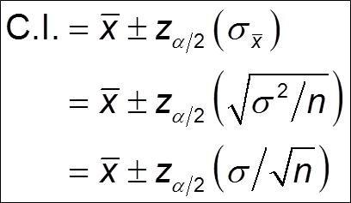

Constructing Confidence Intervals
Case #1: $σ$ is known
How do we find $z_{α/2}$
$α$ = 1 - confidence

Slide 31
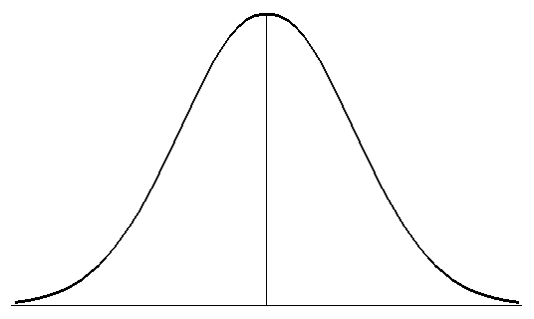
Finding “z” for a 95% CI
Divide confidence in half = .95 / 2 = .4750
This is the probability that lies between the mean and the z-score

Slide 32
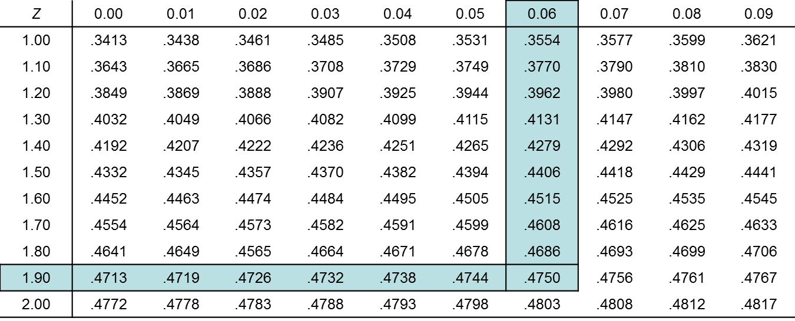
Finding “z” for a 95% CI (cont.)
Find the closest probability in the middle portion of the standard normal (z) distribution

Slide 33

Finding “z” for a 95% CI (cont.)
Identify the z-score = 1.96
Throw the “net” out 1.96 standard-error units from the sample mean
How about other confidence levels?
90%, 99%, 99.9%

Slide 34
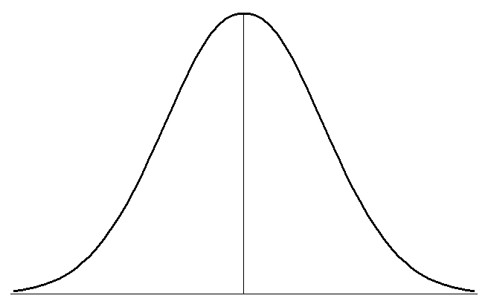
Finding z (cont.)
90% CI
z =
99% CI
z =
99.9% CI
z =

Slide 35
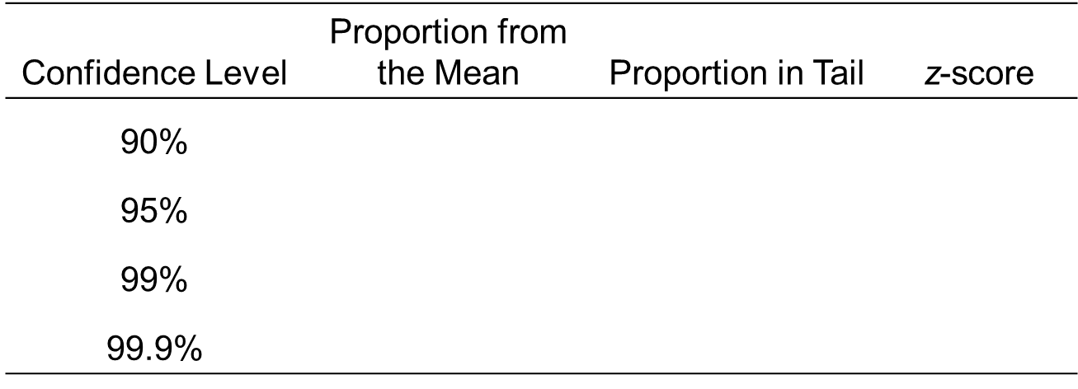
Conventional Confidence Levels

Slide 36
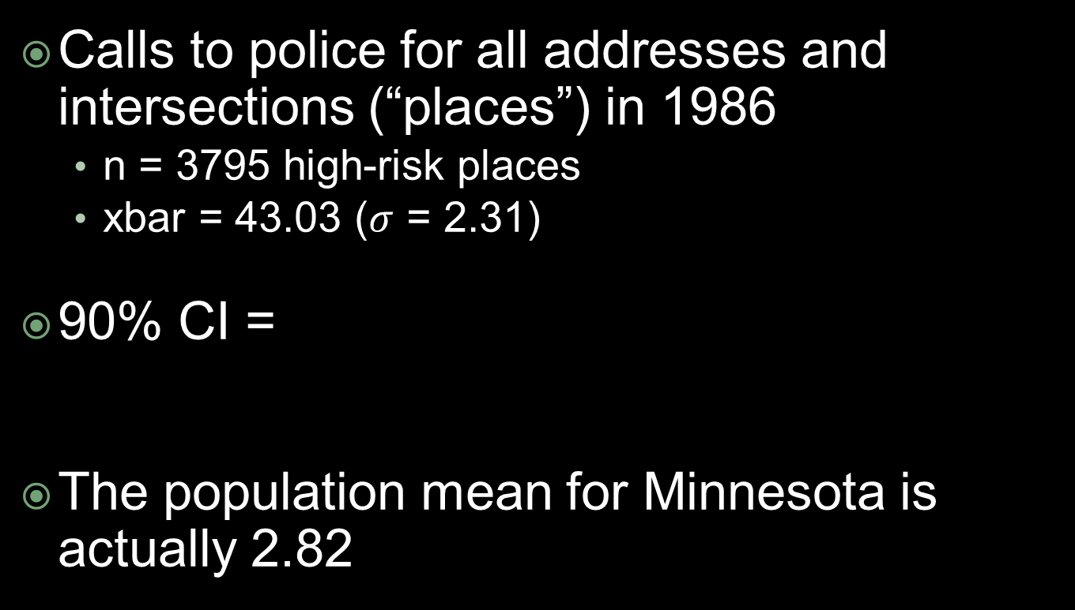
Minneapolis Crime Hot Spots
Calls to police for all addresses and intersections (“places”) in 1986
n = 3795 high-risk places
xbar = 43.03 ($σ$ = 2.31)
90% CI =
The population mean for Minnesota is actually 2.82

Slide 37
Minn. Crime Hot Spots (cont.)
Let’s increase our level of confidence
95% CI =
99% CI =
99.9% CI =

Slide 38
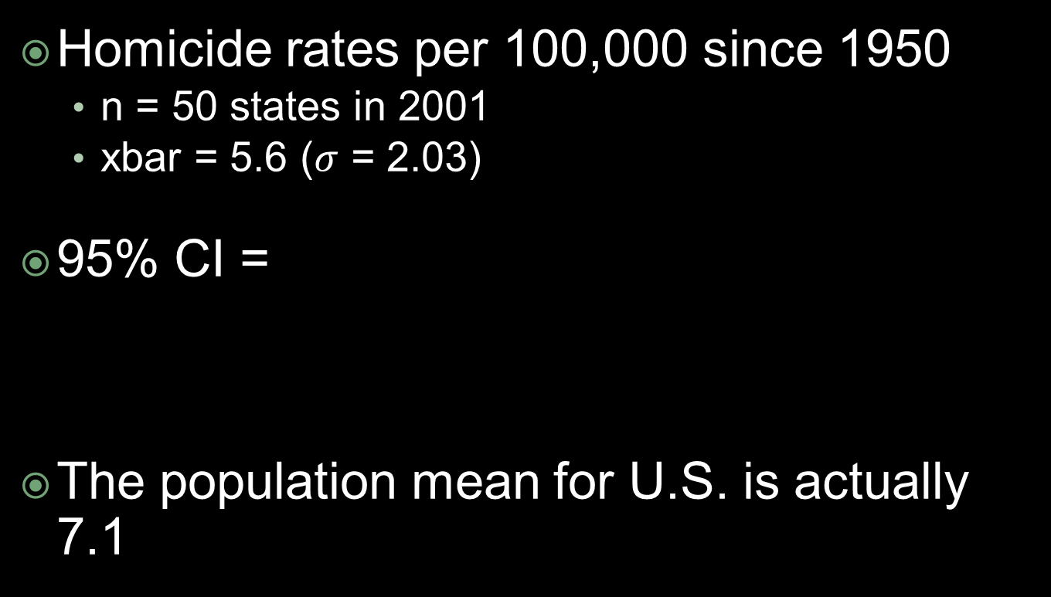
U.S. Homicide Rates
Homicide rates per 100,000 since 1950
n = 50 states in 2001
xbar = 5.6 ($σ$ = 2.03)
95% CI =
The population mean for U.S. is actually 7.1

Slide 39
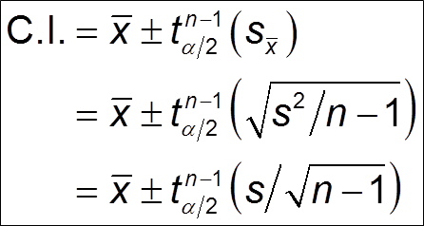

Constructing Confidence Intervals
Case #2: $σ$ is unknown
New probability distribution: t-distribution

Slide 40

t-Distribution
Properties of a t-distribution
Approximately normal
Wider than the z-distribution
Fatter tails
Defined by “degrees of freedom” (df)
Df = n -1
As “n” becomes infinitely large, t-distribution converges to the z-distribution
Always use t-distribution when $σ$ is unknown

Slide 41
t-Distribution (cont.)
With small samples, t is large than z
Reflects the fact that with small “n:, there is greater sample-to-sample variability in the sample mean (i.e., more sampling error)
Finding “t”
Determine level of significance = 1 – confidence
Use “two-tailed significance” for a CI
Calculate degrees of freedom (df)
Identify t-score

Slide 42
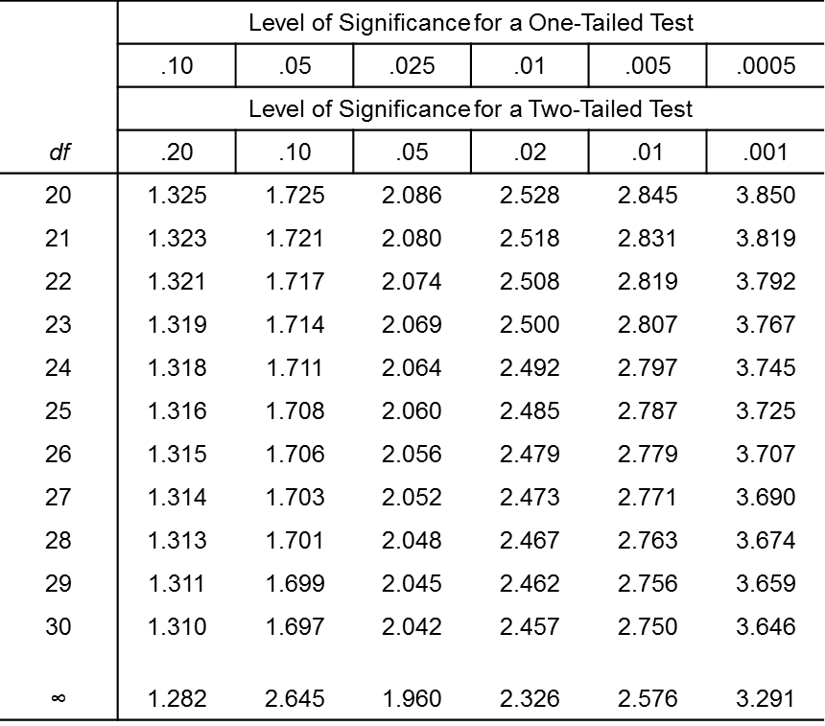
Finding “t”

Slide 43
Prosocial Activities
Prosocial activities among boot campers
n = 1500 youths
xbar = 1.53 (s = 1.21)
99% CI =
Now suppose n = 10

Slide 44
Child Maltreatment
Arrests among young adults with abuse history
n = 61
xbar = 2.57 (s² = 7.90)
95% CI =
99.9% CI =

Slide 45
Child Maltreatment (cont.)
Now suppose n = 250
95% CI =
99.9% CI =

Slide 46
Confidence v. Precision
There is a trade-off between confidence and precision
↑ confidence, ↓ precision
↑ precision, ↓ confidence
No such thing as a free lunch
Being more confident comes at a price: larger interval width

